Slide 1
Udacity self driving car engineer Nanodegree- 1-Computer Vision
Document created by – Poluri Nikhil Koundinya
IMAGE CLASSIFICATION USING CNNs

Slide 2
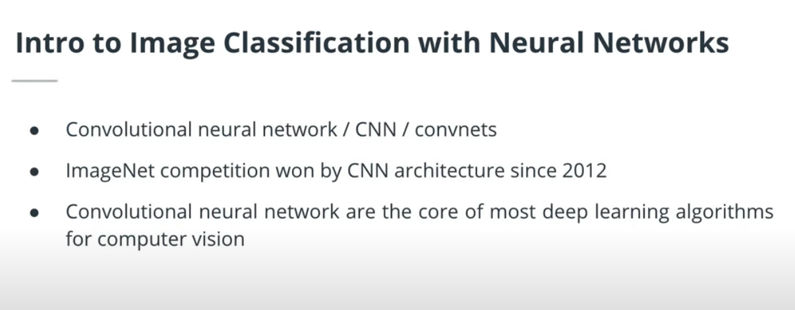
This lesson will focus on Convolutional Neural Networks, also known as CNNs or Convnets. CNNs are a special type of neural network particularly well suited to image data. Since 2012, the ImageNet competition(opens in a new tab) has always been won by CNN architectures.
In this lesson, we will tackle:
Limitations of feed-forward networks
The convolution layer (conv layer)
Pooling layers, dropout and batch normalization (batchnorm)
Build a custom architecture to classify traffic signs
Modern architectures
Augmentations

Slide 3
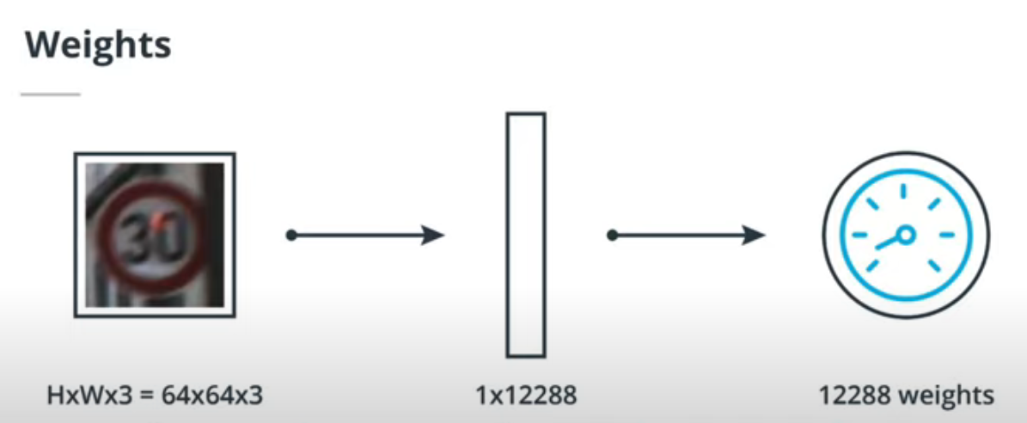
Flattening the image is required to use it as an input to a fully connected layer. In the previous lesson, we saw that a fully connected layer of n neurons following a layer of m neurons has (m+1)xn parameters.
If our network has a single layer of 10 neurons and if we are using images of resolution 64x64x3, this layer will have 122880 weights and 10 biases. This is not going to scale well with more layers, more neurons and a higher image resolution. Thankfully, convolutional layers will help solve this problem!
Instead of flattening the image, we are now considering the image as an input volume. The convolutional layer, as opposed to the fully connected layer, will be locally connected. Indeed, each neuron in the convolutional layer will only be connected to small portion of the input volume.

Slide 4
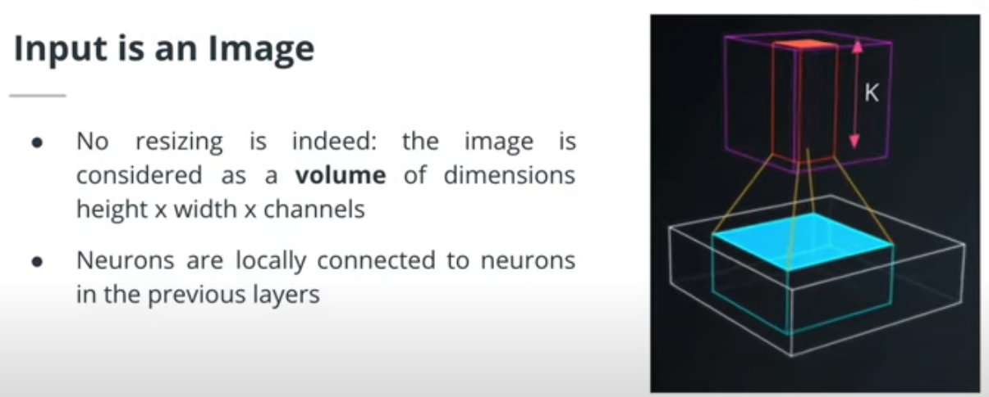
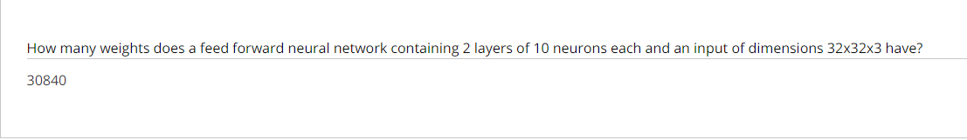

Slide 5
We can calculate the number of weights in a feed-forward neural network by considering the connections between neurons in each layer. Here's how to find the weights for the given network:
Input to First Hidden Layer:
Each neuron in the first hidden layer (10 neurons) will have connections to all elements of the input (32x32x3 = 3072 elements).
Weights: 10 neurons * 3072 elements/neuron = 30720
First Hidden Layer to Second Hidden Layer:
Each neuron in the second hidden layer (10 neurons) will have connections to all neurons in the first hidden layer (10 neurons).
Weights: 10 neurons * 10 elements/neuron = 100
Total Weights:
Weights from input to first hidden layer + weights between hidden layers
30720 weights + 100 weights = 30820 weights
Considering Bias:
It's common practice to include a bias term for each neuron (except the input layer) in a neural network. This bias term acts like an additional weight with a constant value (usually 1). Including bias adds the following weights:
Bias weights: 10 neurons (first hidden layer) + 10 neurons (second hidden layer) = 20 weights
Total Weights with Bias:
Total weights without bias + bias weights
30820 weights + 20 weights = 30840 weights
Therefore, the feed-forward neural network with the given architecture has approximately 30,840 weights (considering bias terms).

Slide 6
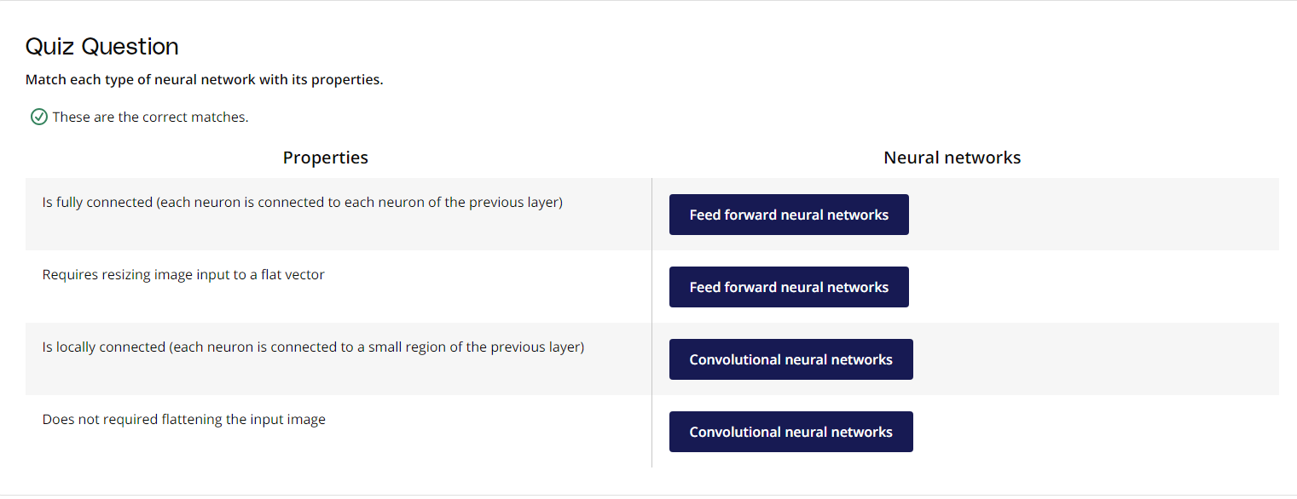

Slide 7
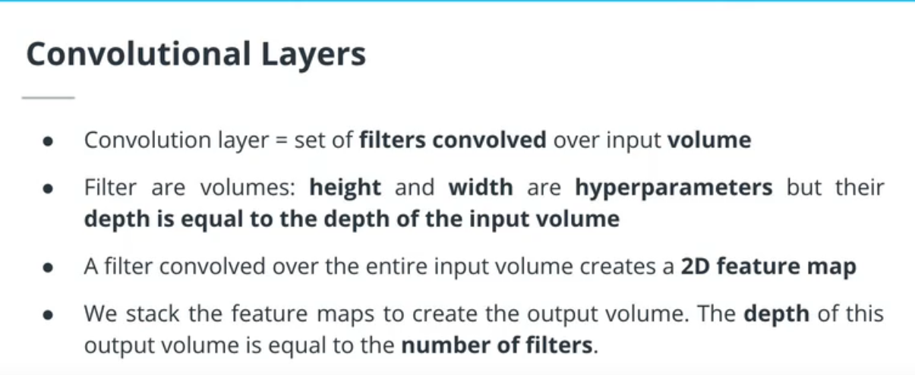
Introducing Convolutional Layers
A convolutional layer is made of filters. Such filters are HxWxD arrays of learnable weights that are sliding or convolving over the input volume. Each filter is convolved over the entire input volume. The convolution of such a filter creates an 2D output array called a feature map. Because a convolutional layer has multiple filters, it outputs multiple feature maps. They will be stacked together to create the output volume.
The filters in a convolutional layer are defined by two hyperparameters: the height and width. They are usually small and the most common filter sizes are 3x3 or 5x5.

Slide 8
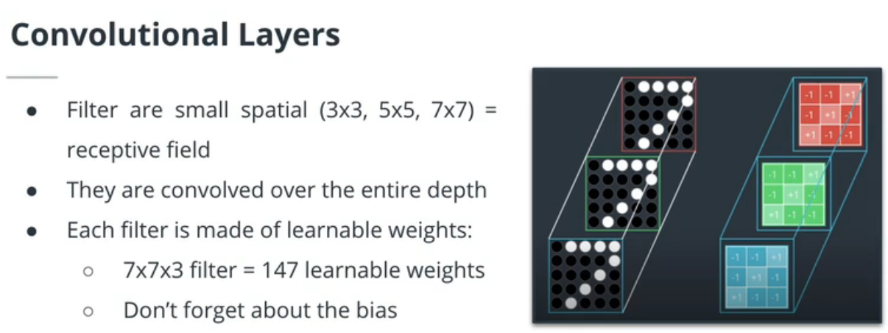
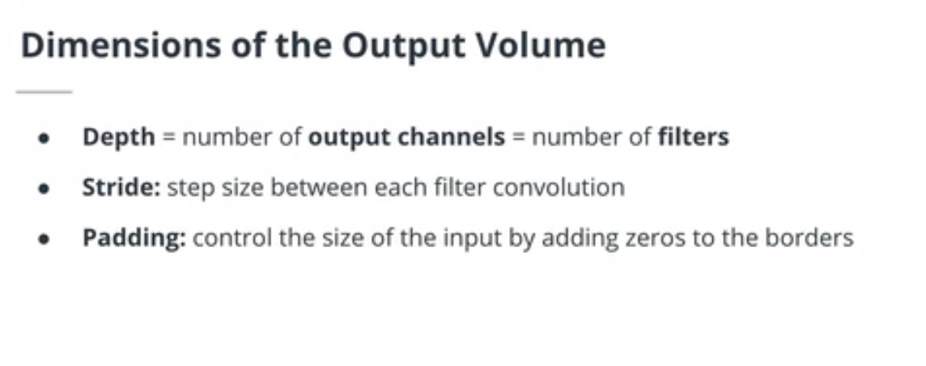
The Convolution Operation

Slide 9
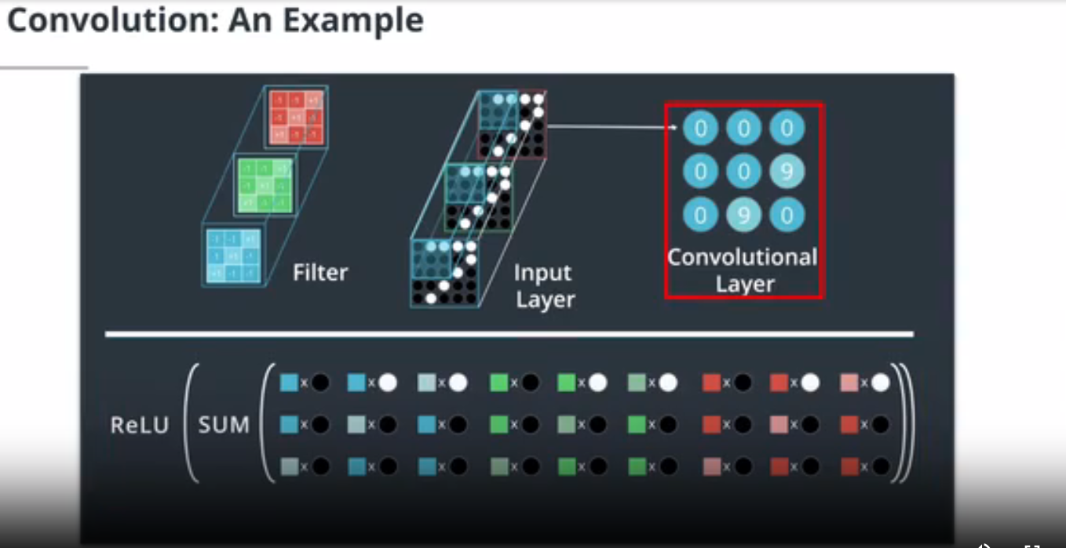
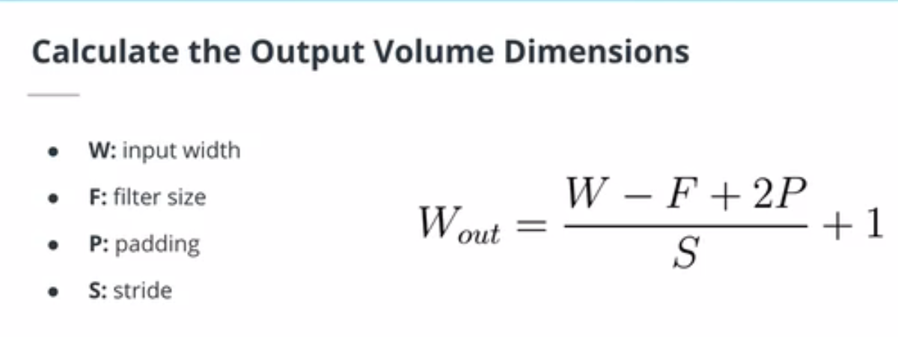
In addition to the filter size F , a convolutional layer has additional hyperparameters. The stride S controls the size of the step by which the filter is moving. The padding P controls the size of the output by adding zeros (or other values) to the border of the input.
The spatial dimensions of the output volume can be calculated using the formula below. We are calculating the width of the output volume but the same formula would apply for the height.

Slide 10
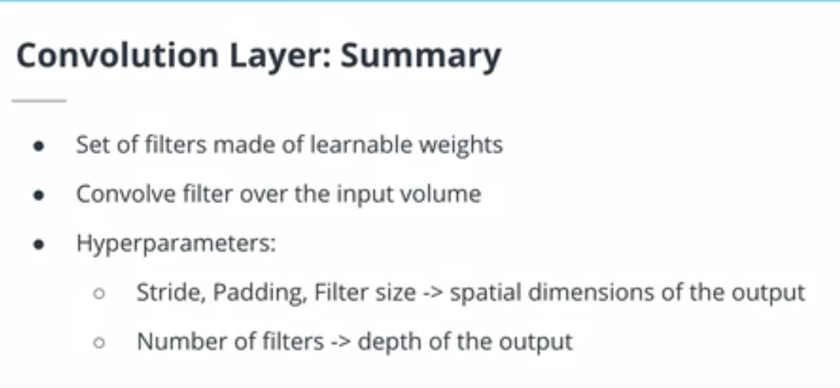

Slide 11
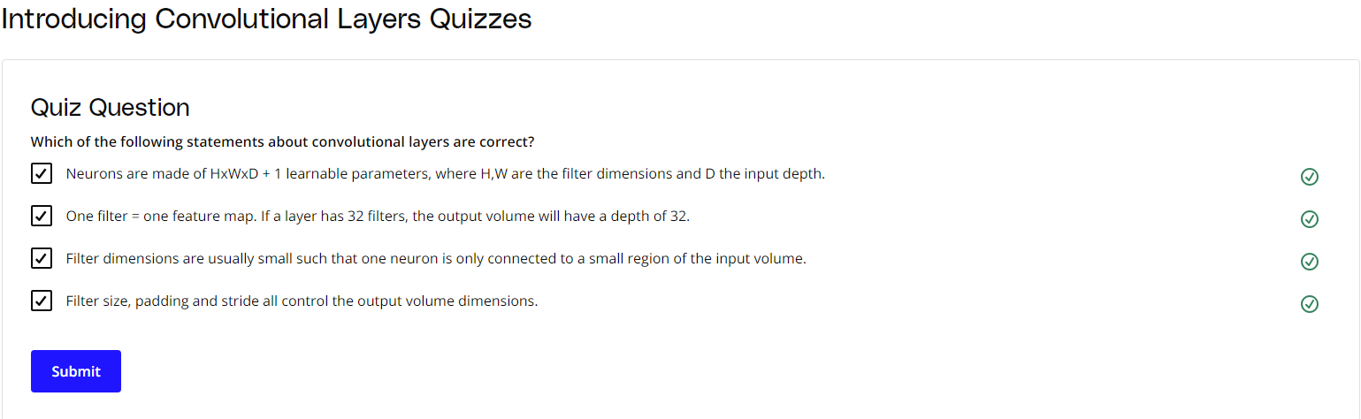
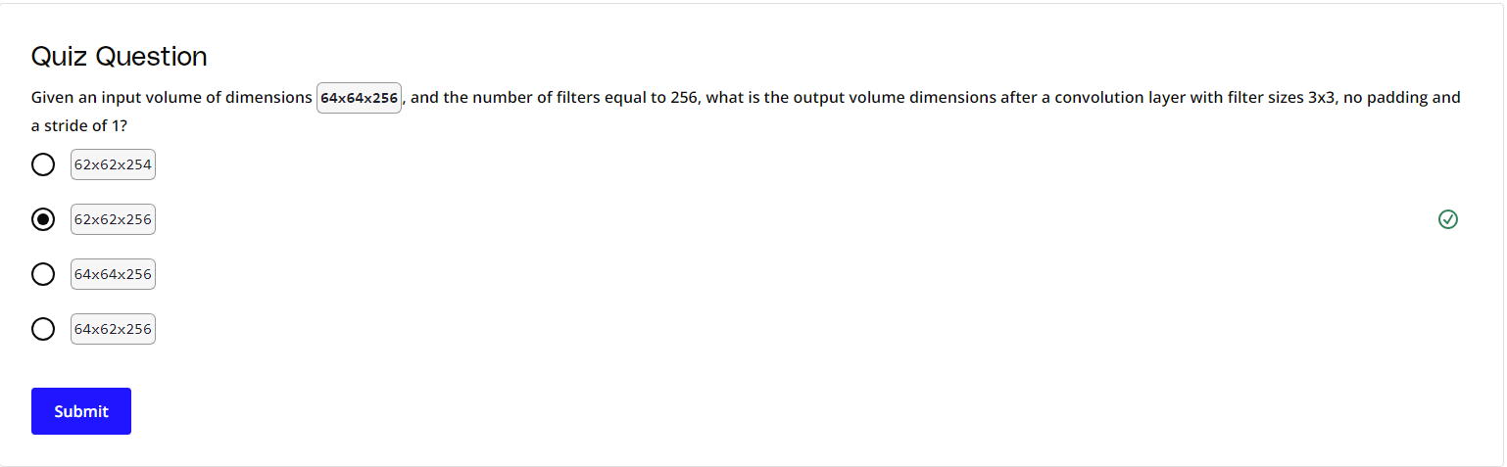

Slide 12
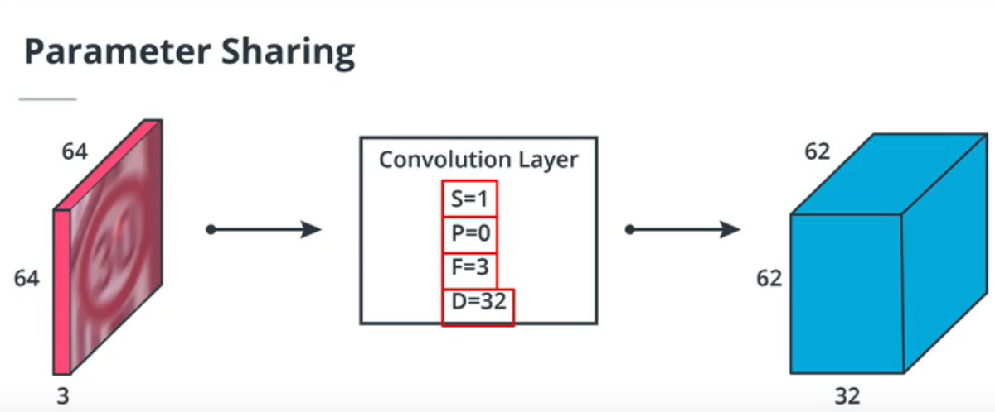
Convnet Layers and Parameters
At approximately 3:05, the math performed on the slide includes the bias parameter in the math, which I do not include while talking, leading to 27x64 instead of the 28x64 on the slide.
A filter acts as a feature detector in convolutional layers, and the deeper the layer, the more specialized the filters are. For example, when training an algorithm to classify dog and cat images, a filter in a deep layer might be a left ear detector.
The number of parameters in a convolutional layer is determined by the filter size, the number of filters and the depth of the input volume D. If we consider a 3x3 filter size with 32 filters:
each filter has 3x3xD + 1 learnable parameters
the whole layer has (3x3xD+1)x32 learnable parameters
CNNs have in general a few millions parameters but some mobile-oriented architectures barely reach one million.

Slide 13
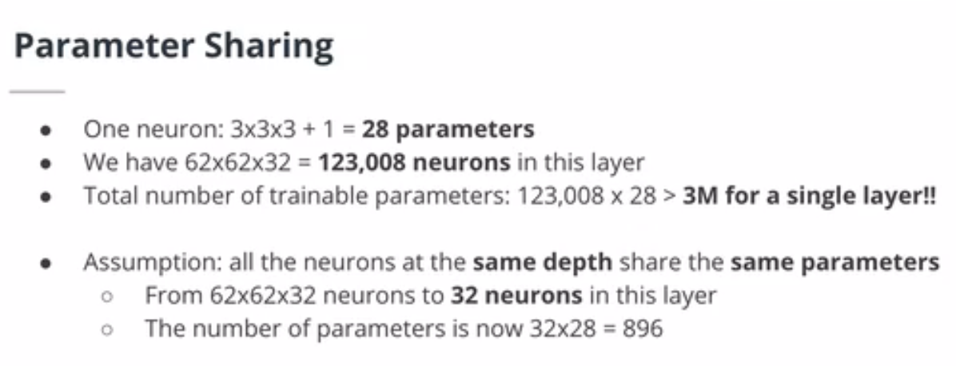
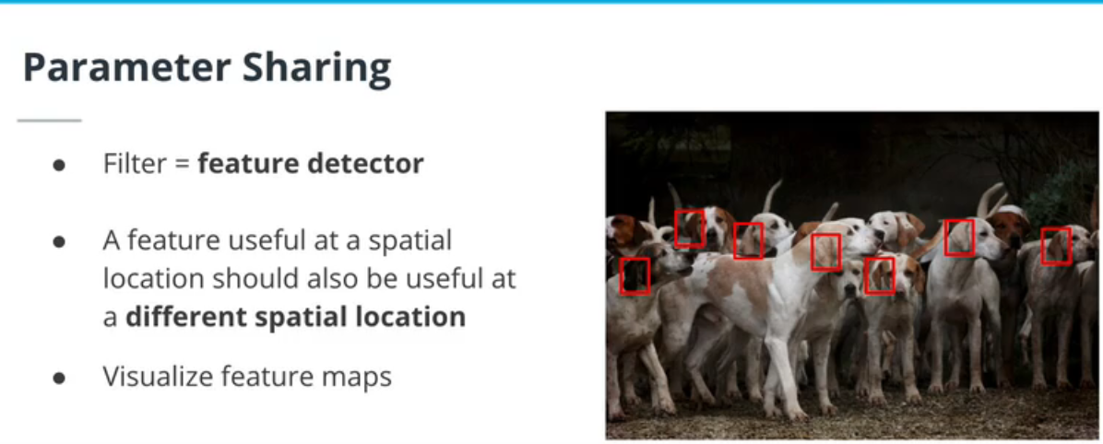

Slide 14
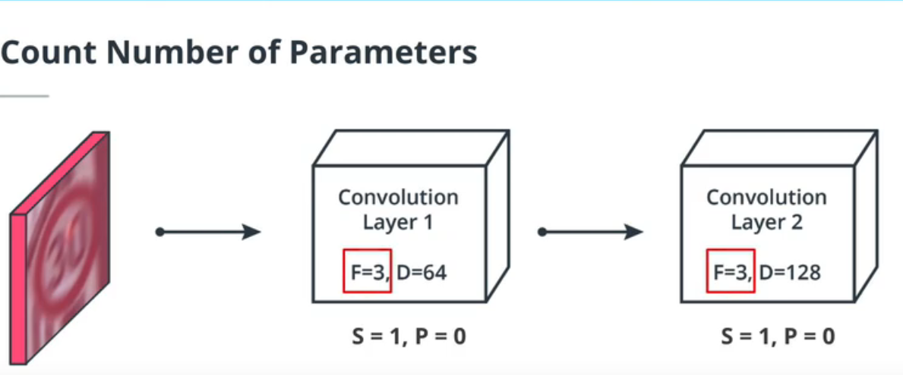
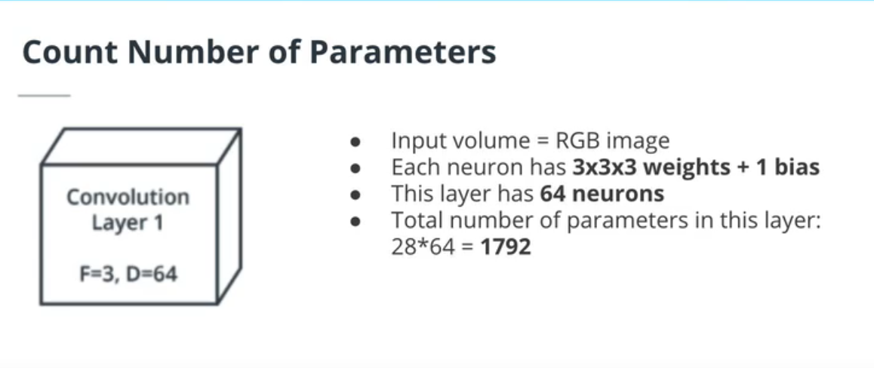

Slide 15
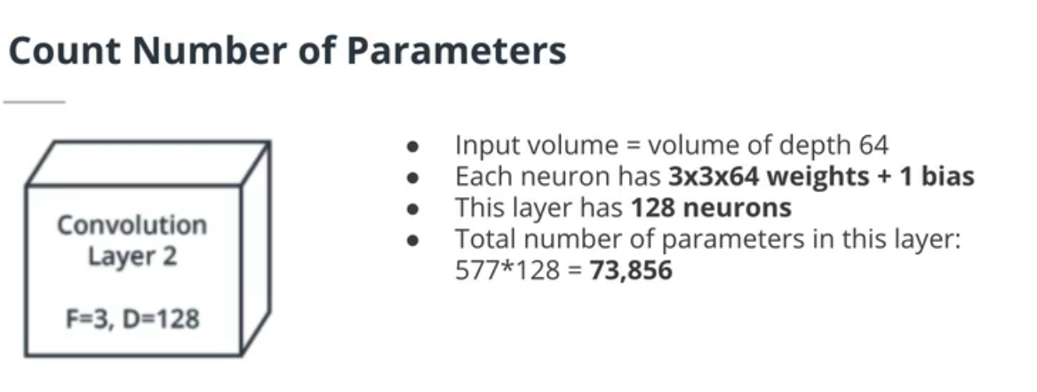
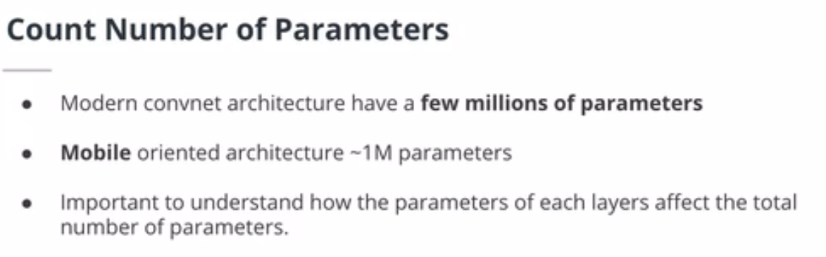

Slide 16
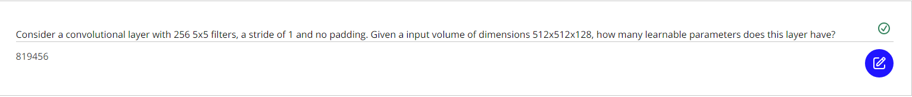
Convnet Layers and Parameters Quizzes

Slide 17
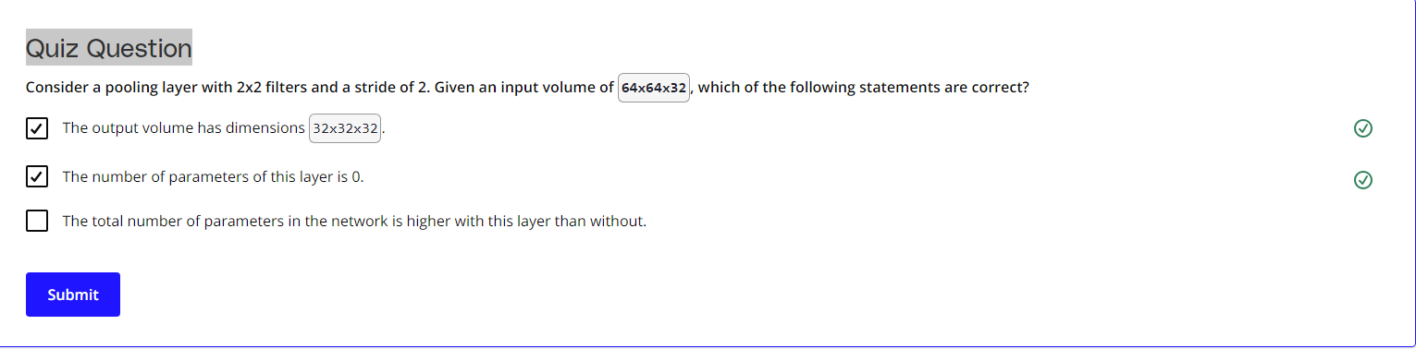
Pooling Layers
Pooling layers are very common in CNNs. They decrease the number of parameters in the network by aggregating spatial information, usually by taking the mean (average pooling) or the max (max pooling). They do not have any learnable parameters.

Slide 18
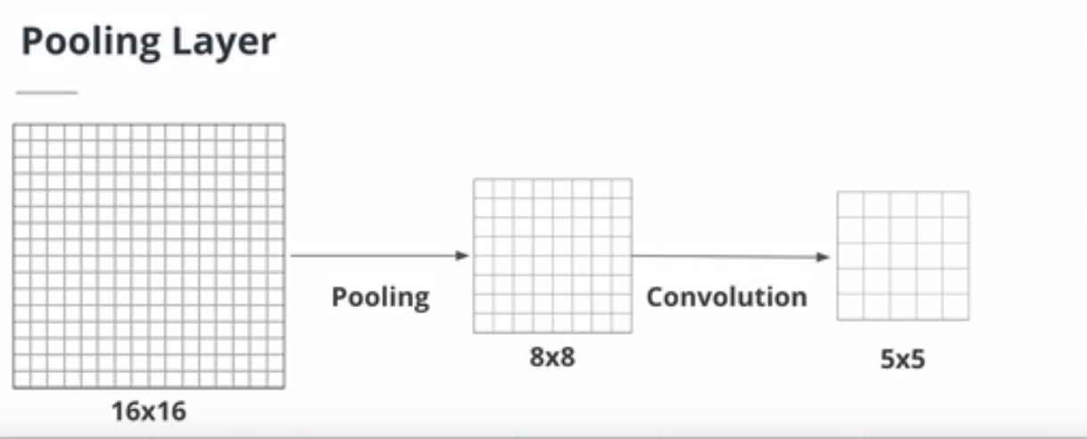
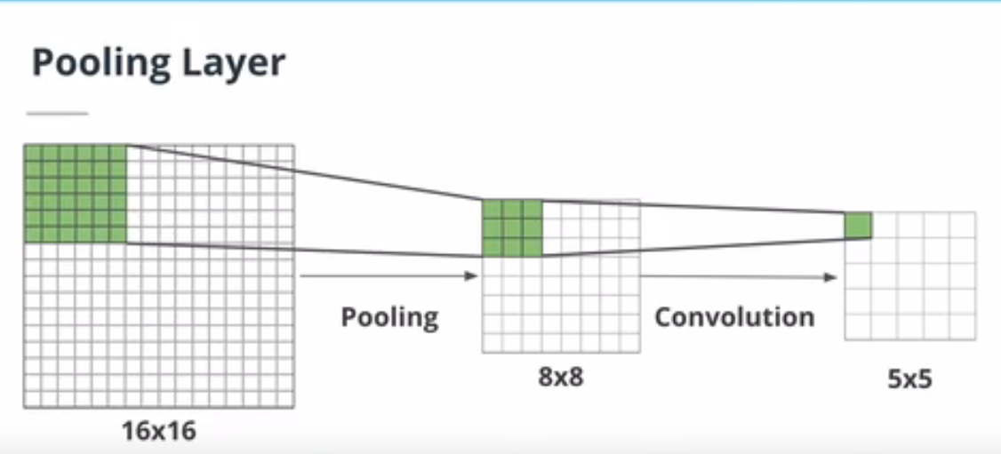

Slide 19
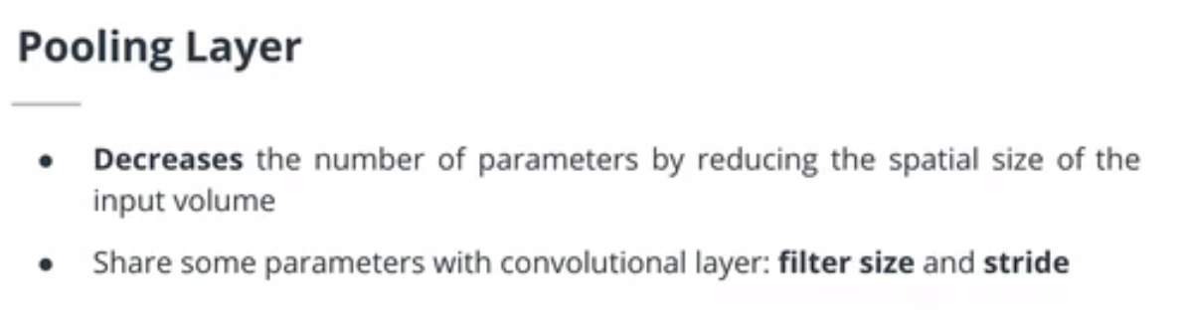
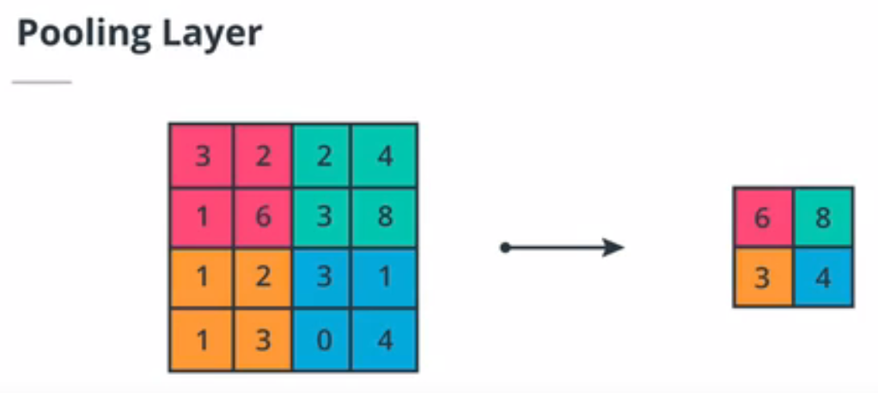
Maxpooling
Similarly we can do average pooling as well

Slide 20
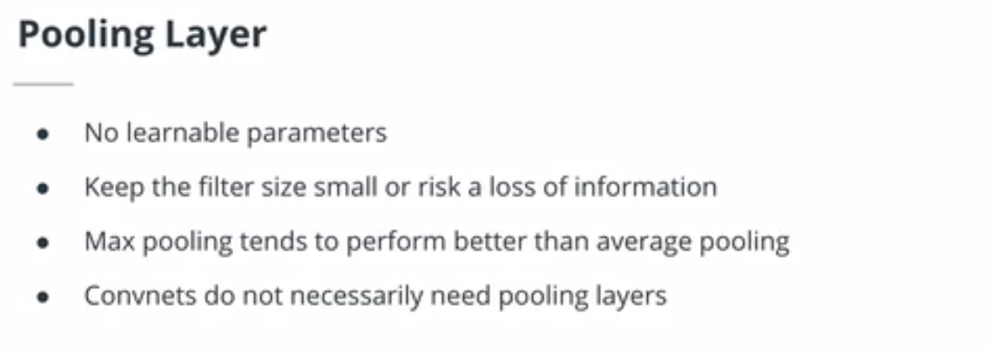

Slide 21
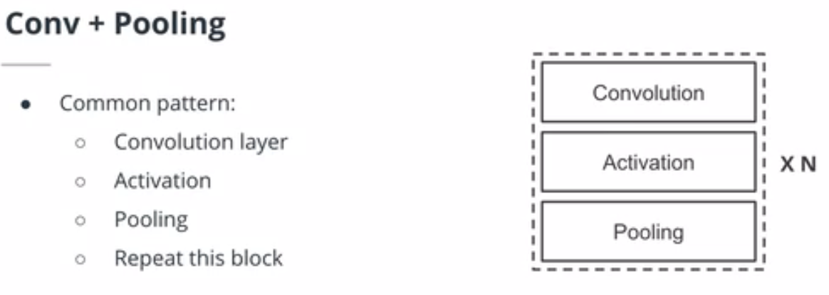
Typical Conv Net Architecture
The following pattern is common in CNNs architectures:
Convolutional layer
Activation
Pooling
Such block of layers is then repeated. Another common strategy is to increase the number of filters in convolutional layers with depth.
The output of the last convolutional layer is flattened and fed into a classic feedforward NN, called a classifier, similar to the ones seen in the previous lesson. Because the first fully connected layer of the classifier needs a fixed size input, CNNs with such designs require a fixed resolution input image.

Slide 22
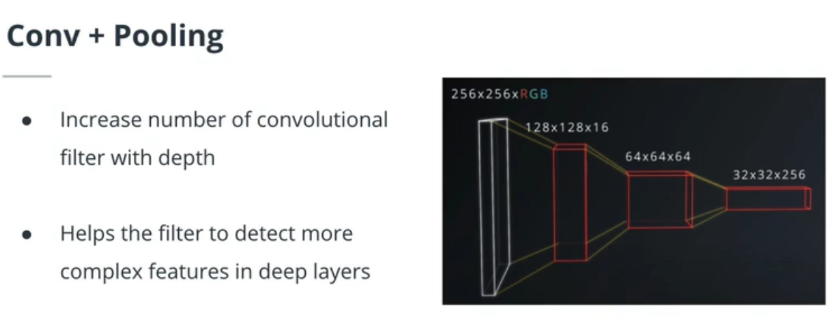
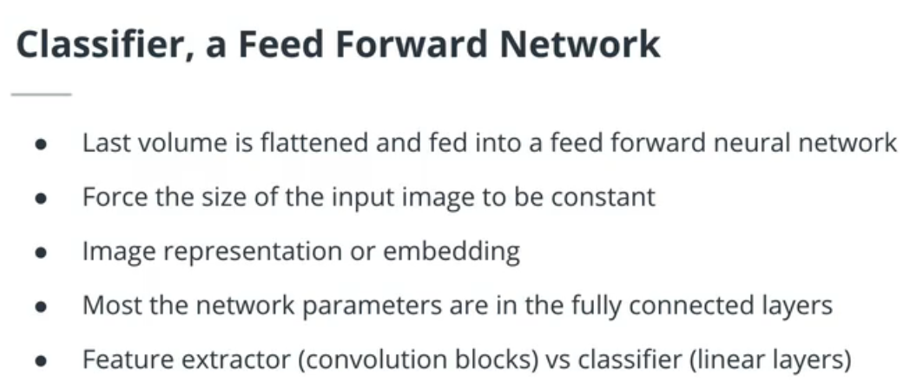

Slide 23
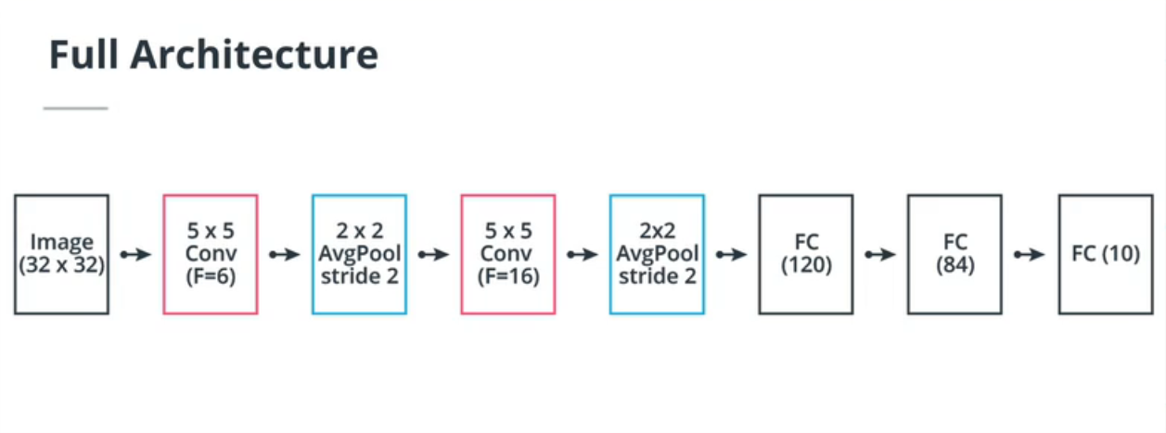

Slide 24
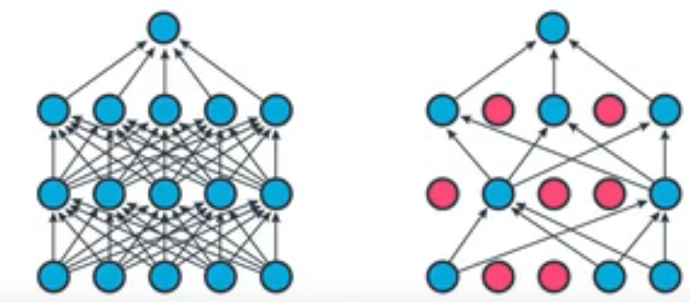
Dropout and Batch Normalization
Dropout
Dropout was introduced in a 2014 paper(opens in a new tab) as a way to prevent overfitting. Dropout can be used in fully connected or convolutional layers and simply randomly disable neurons during training. Dropout does not have any learnable parameters and has only one hyperparameter, the probability p of a neuron being disabled.
It is important to note that Dropout does not behave similarly during training and testing. Indeed, because we want the behavior of our model to be deterministic in production, dropout is turned off and neurons are not randomly disabled anymore. The main consequence of this is the need to scale the neurons output. To be understand this, let us consider a simple fully connected layer containing 10 neurons. We are using a dropout probability of 0.5. Well during training, a neuron in the next fully connected layer will on average receive an input from 5 neurons. However, during testing, the same neurons will receive an input from 10 neurons. To get a similar behavior during training and testing, we need to scale the neuron's output by 0.5 during testing time.
In practice, we use something called inverted dropout, where scaling is happening during training. Why? Because we want the model to be as fast as possible when deployed, so we'd rather have even this small operation happen during training instead of at inference time.

Slide 25
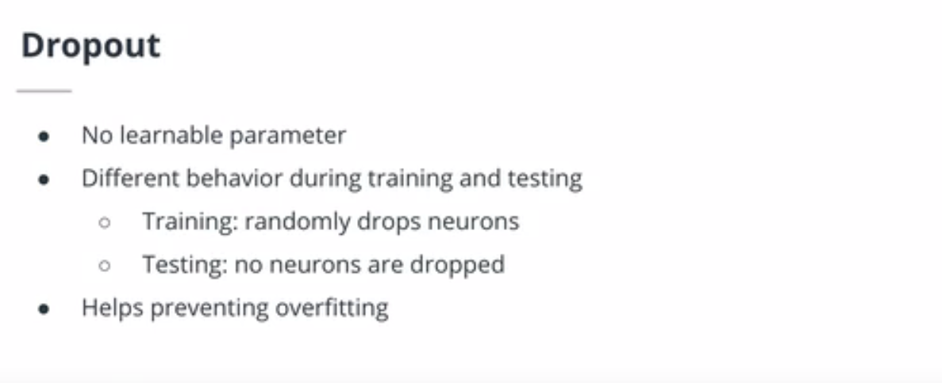

Slide 26
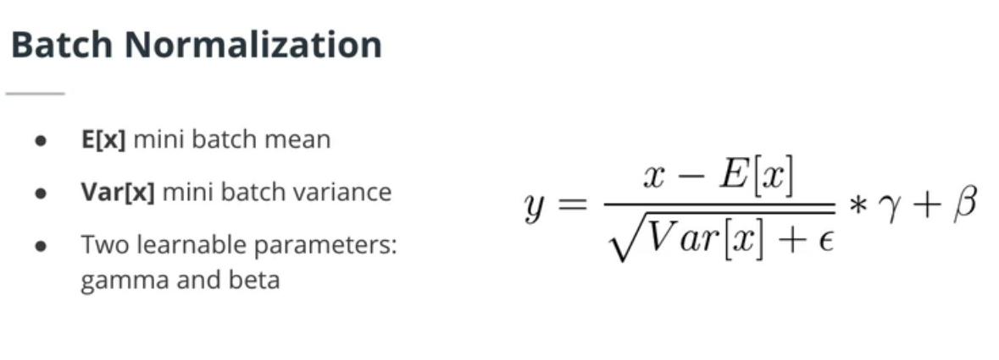
Batch Normalization or Batchnorm was first introduced in a 2015 paper(opens in a new tab). A batchnorm layers computes batch statistics and scales its inputs using these statistics. By doing so, Batchnorm improves the convergence time of neural networks. Similarly to Dropout, Batchnorm behaves differently during training and testing. During training, this layer calculates an exponential moving average of batch statistics. During testing, these statistics are used instead of the batch statistics from the test batches.

Slide 27
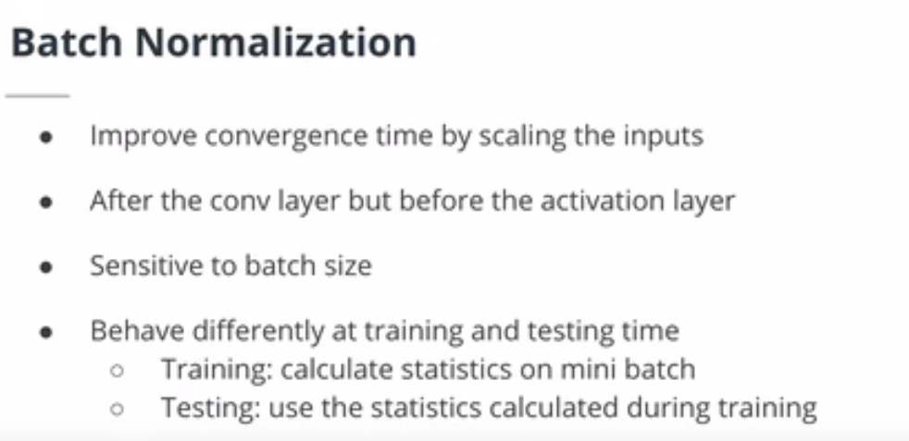

Slide 28
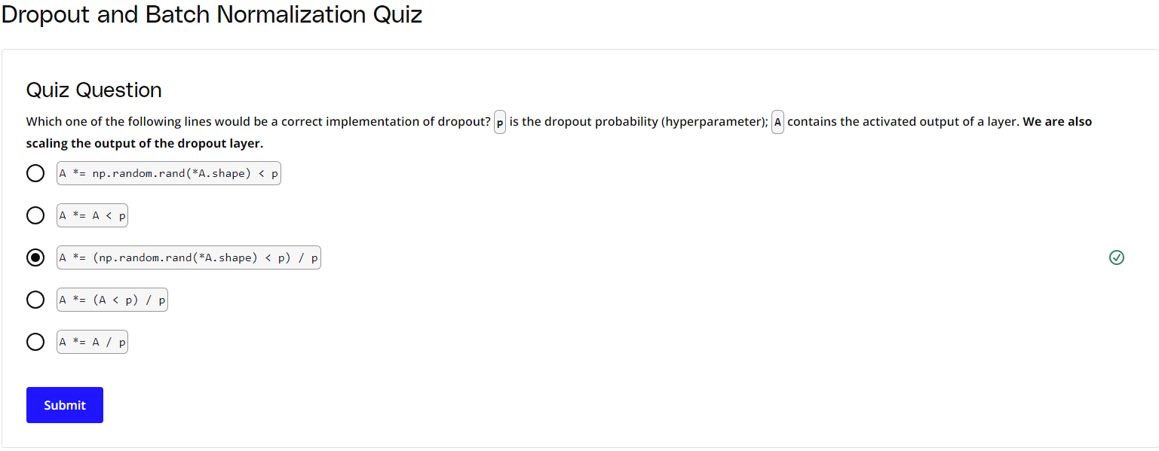

Slide 29
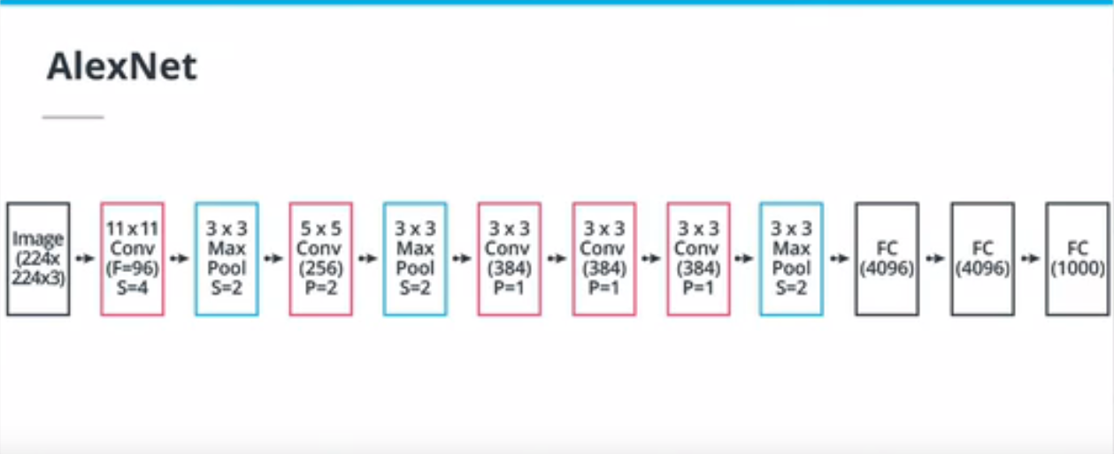
Build a Custom Architecture
AlexNet
The Alexnet architecture was a critical breakthrough in the field of computer vision for deep learning. In this 2012 paper(opens in a new tab), the authors successfully used a CNN trained on GPU to classify images.

Slide 30
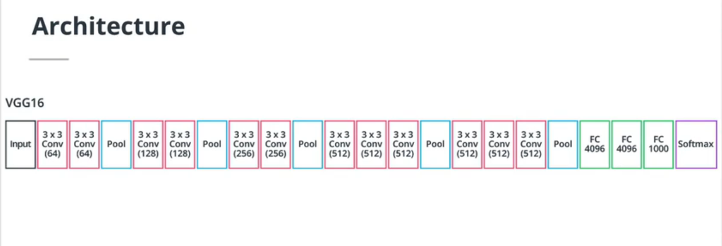
VGG
In this 2015 paper(opens in a new tab), the authors introduced two very important concepts:
using smaller filter sizes, in this case 3x3 filters.
using convolutional blocks: blocks of 2 or 3 convolutional layers followed by one pooling layer.
By stacking multiple convolutional layers with small filters, we create a block that has less parameters than a single layer with larger filter sizes, while having the same effective receptive field and more non-linearities.

Slide 31
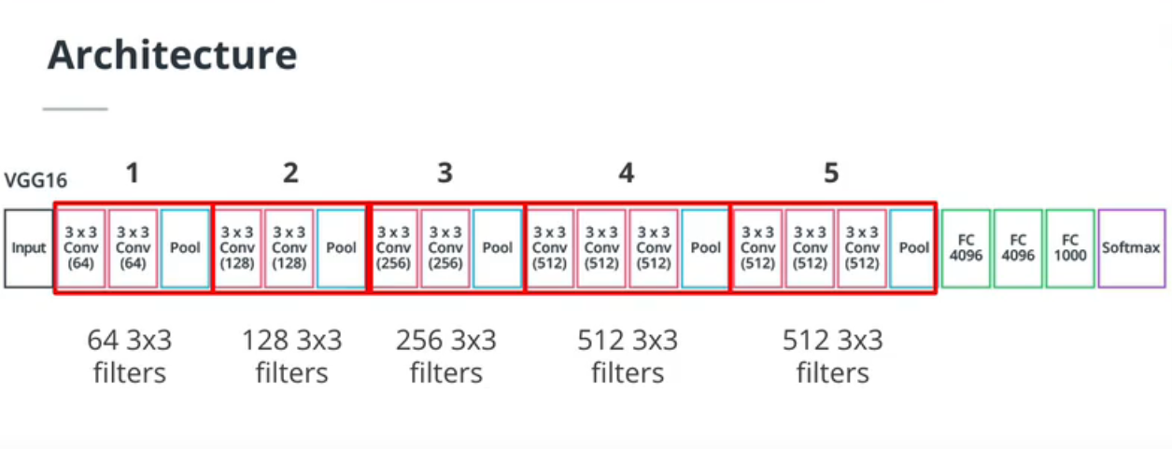
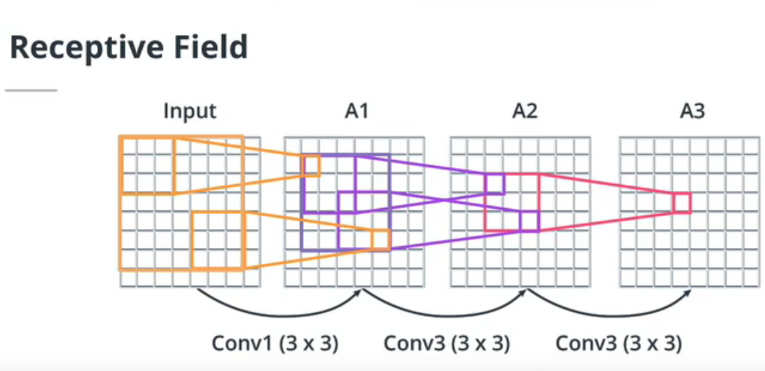

Slide 32
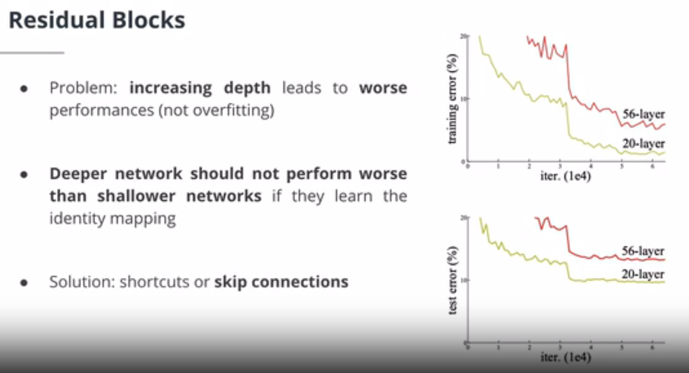
ResNet
In another very important paper published in 2015(opens in a new tab), the authors introduced the Resnet architecture. They realized that networks with more layers started underperforming. To solve this and allow for deeper networks, the authors introduced the concept of residual connections or skip connections. A skip connection simply adds the input of a layer or a block of layers to its output. By doing so, it will alleviate gradient propagation issues linked to activation functions.
Inception
One last neural network that may be of interest to you is the Inception network, introduced in this 2014 paper(opens in a new tab). While it is beyond the scope of this course, it also has some interesting and ground-breaking research, such as the use of multiple different sizes of convolutional filters within a "layer", as well as the use even of 1x1 filters, enabling deep networks with often fewer parameters. Make sure to check out the paper if you want to dive deeper!

Slide 33
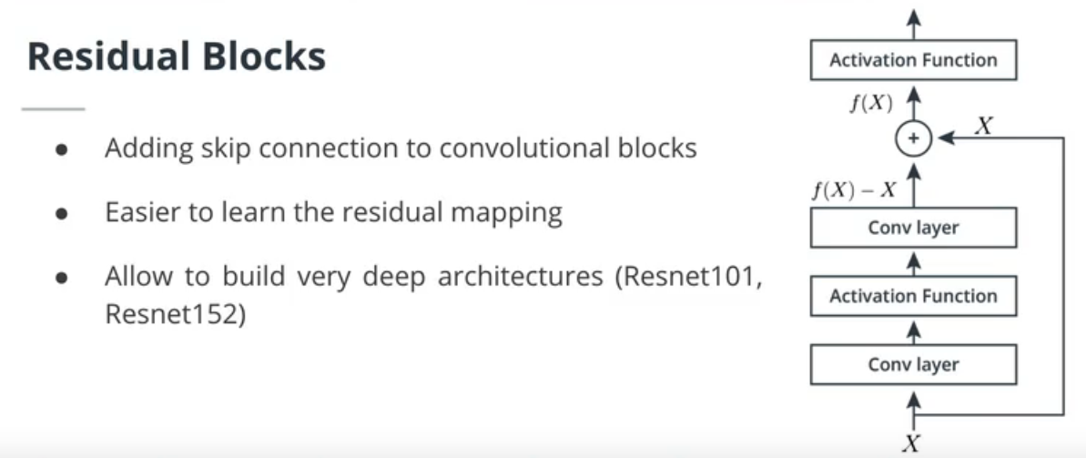

Slide 34
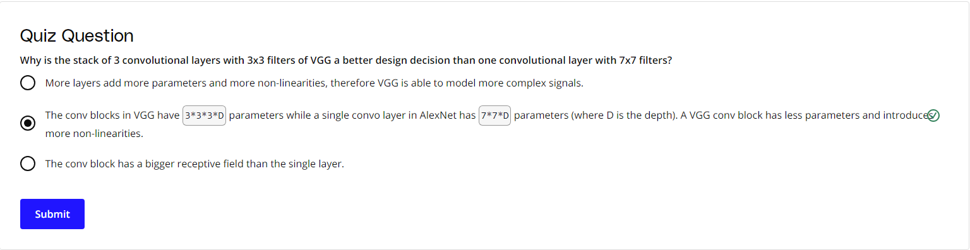
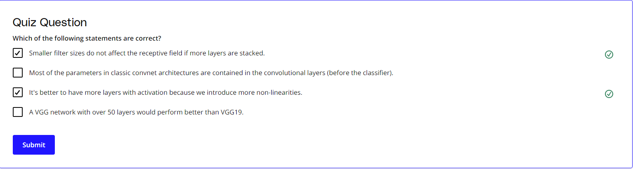

Slide 35
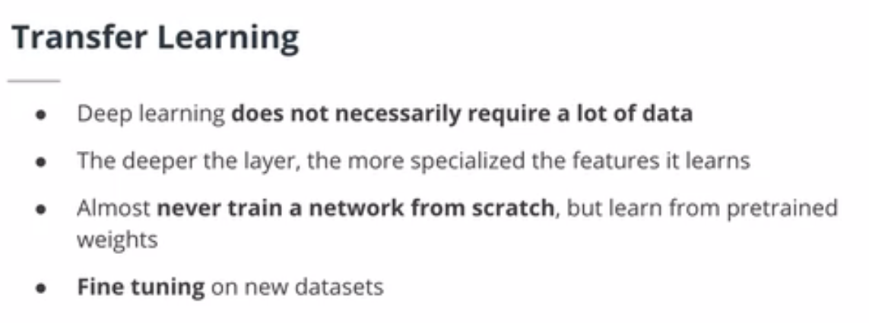
Transfer Learning
The Four Main Cases When Using Transfer Learning
Transfer learning involves taking a pre-trained neural network and adapting the neural network to a new, different data set.
Depending on both:
the size of the new data set, and
the similarity of the new data set to the original data set
the approach for using transfer learning will be different. There are four main cases:
new data set is small, new data is similar to original training data
new data set is small, new data is different from original training data
new data set is large, new data is similar to original training data
new data set is large, new data is different from original training data

Slide 36
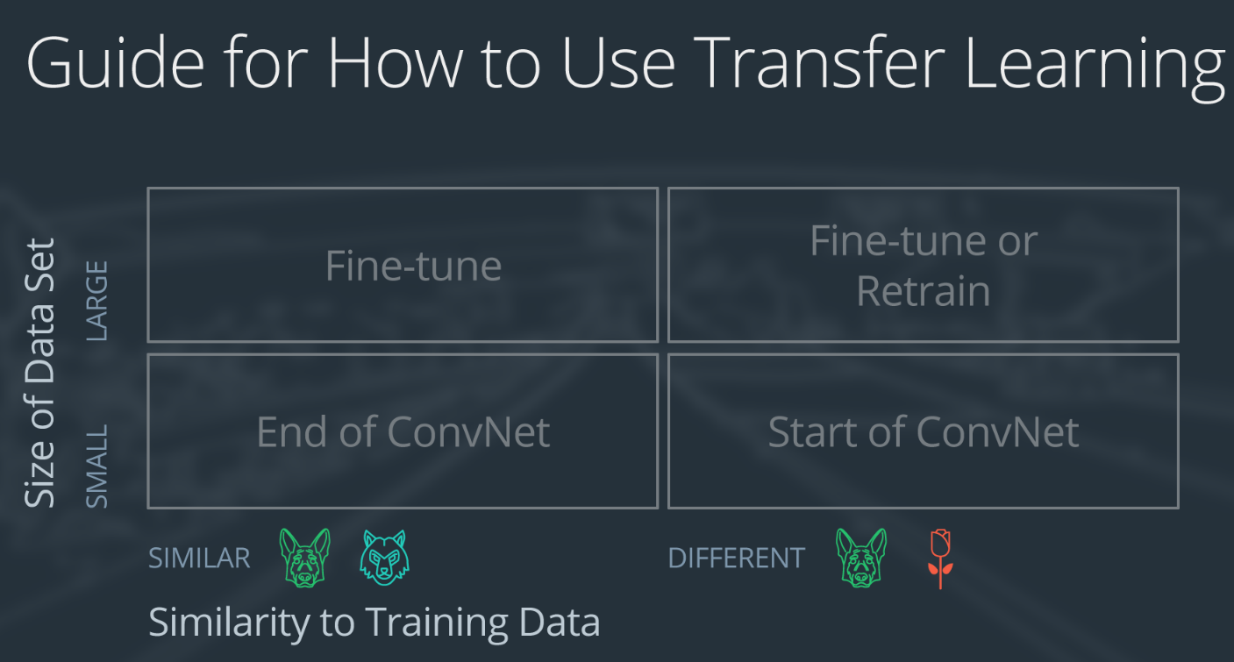
A large data set might have one million images. A small data could have two-thousand images. The dividing line between a large data set and small data set is somewhat subjective. Overfitting is a concern when using transfer learning with a small data set.
Images of dogs and images of wolves would be considered similar; the images would share common characteristics. A data set of flower images would be different from a data set of dog images.
Each of the four transfer learning cases has its own approach. In the following sections, we will look at each case one by one.

Slide 37
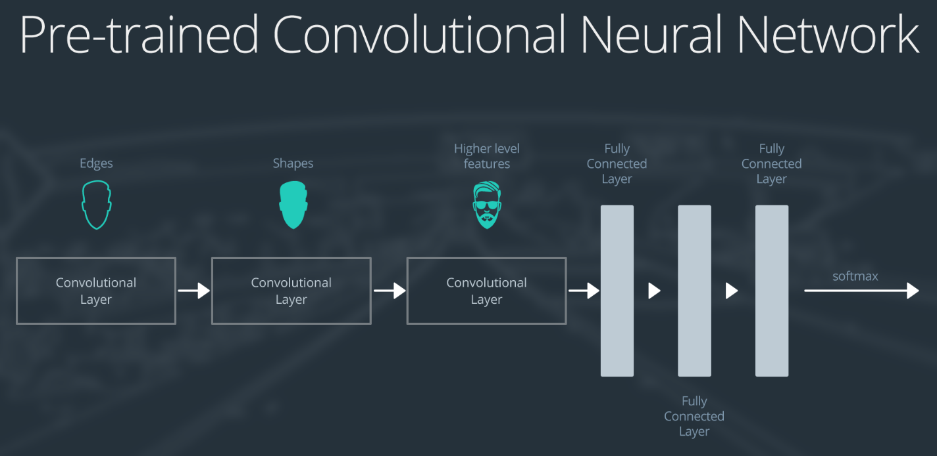
Demonstration Network
To explain how each situation works, we will start with a generic pre-trained convolutional neural network and explain how to adjust the network for each case. Our example network contains three convolutional layers and three fully connected layers:

Slide 38
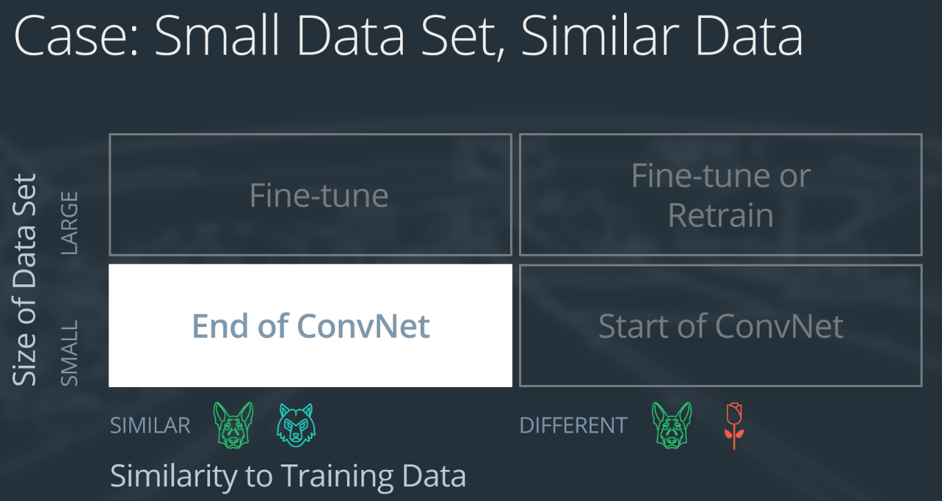
Here is an generalized overview of what the convolutional neural network does:
the first layer will detect edges in the image
the second layer will detect shapes
the third convolutional layer detects higher level features
Each transfer learning case will use the pre-trained convolutional neural network in a different way
Case 1: Small Data Set, Similar Data

Slide 39
If the new data set is small and similar to the original training data:
slice off the end of the neural network
add a new fully connected layer that matches the number of classes in the new data set
randomize the weights of the new fully connected layer; freeze all the weights from the pre-trained network
train the network to update the weights of the new fully connected layer
To avoid overfitting on the small data set, the weights of the original network will be held constant rather than re-training the weights.
Since the data sets are similar, images from each data set will have similar higher level features. Therefore most or all of the pre-trained neural network layers already contain relevant information about the new data set and should be kept.
Here's how to visualize this approach:

Slide 40
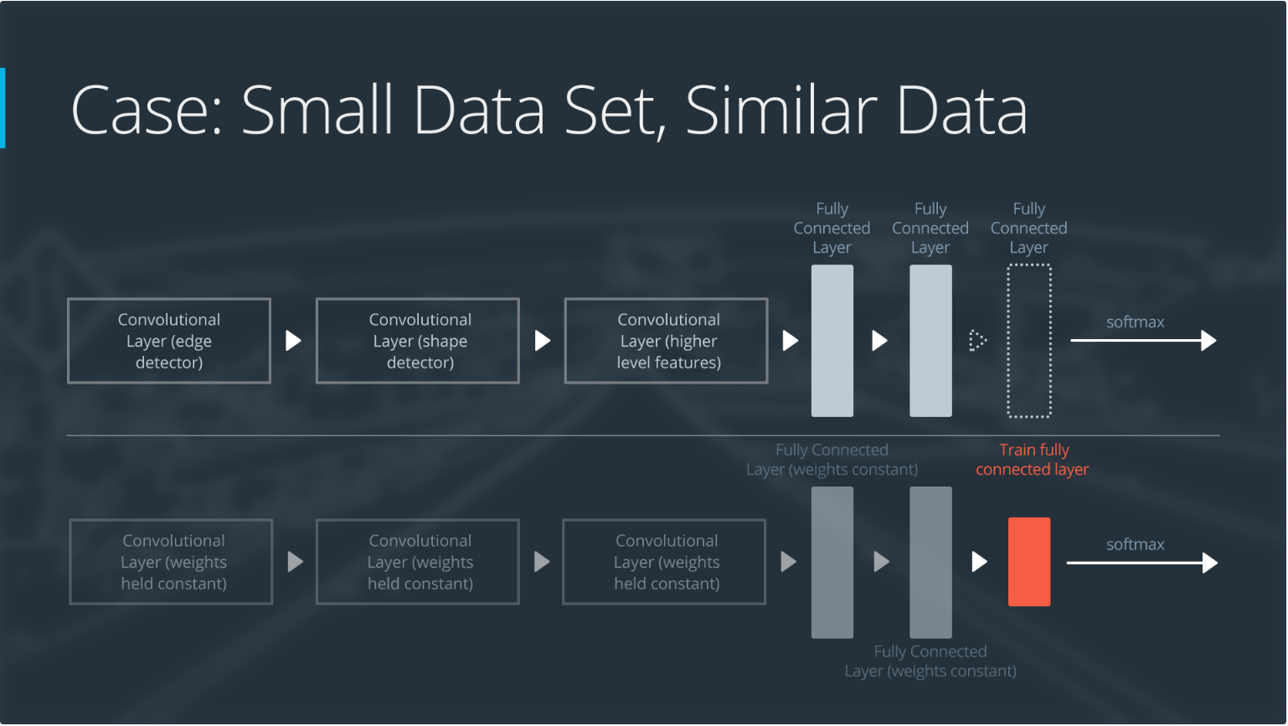

Slide 41
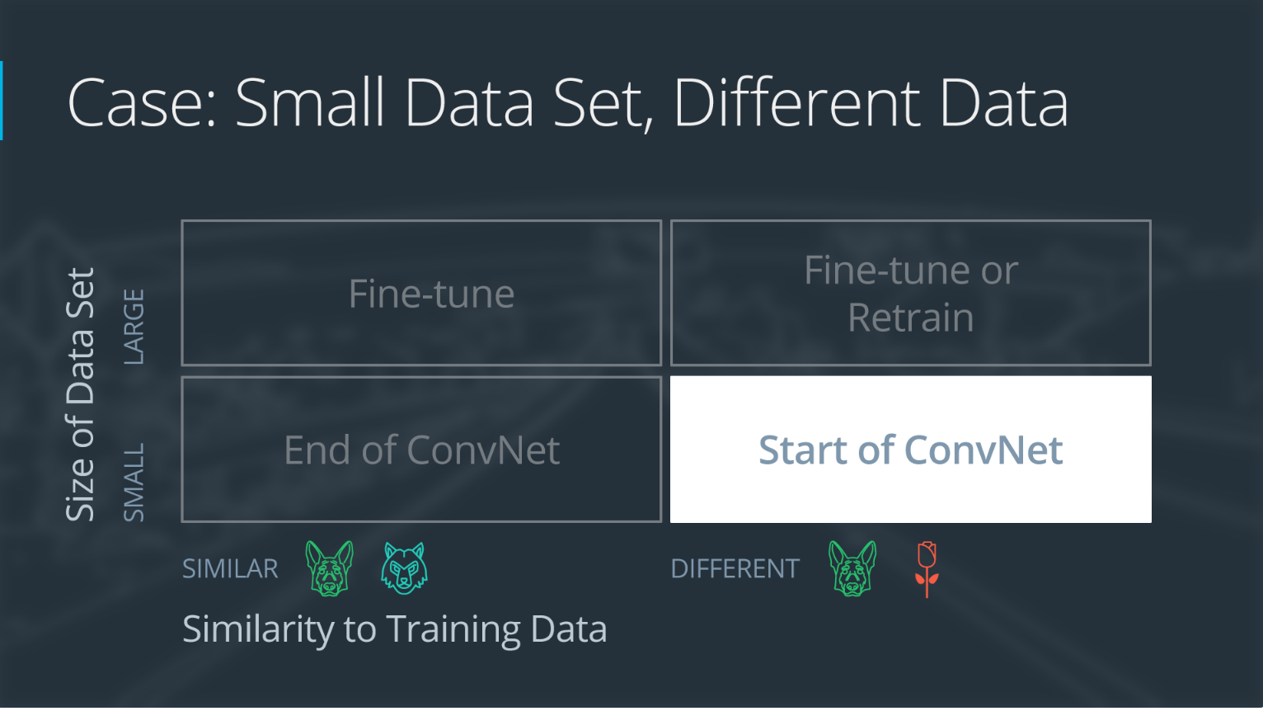
Case 2: Small Data Set, Different Data

Slide 42
If the new data set is small and different from the original training data:
slice off most of the pre-trained layers near the beginning of the network
add to the remaining pre-trained layers a new fully connected layer that matches the number of classes in the new data set
randomize the weights of the new fully connected layer; freeze all the weights from the pre-trained network
train the network to update the weights of the new fully connected layer
Because the data set is small, overfitting is still a concern. To combat overfitting, the weights of the original neural network will be held constant, like in the first case.
But the original training set and the new data set do not share higher level features. In this case, the new network will only use the layers containing lower level features.
Here is how to visualize this approach:

Slide 43


Slide 44

Case 3: Large Data Set, Similar Data

Slide 45
If the new data set is large and similar to the original training data:
remove the last fully connected layer and replace with a layer matching the number of classes in the new data set
randomly initialize the weights in the new fully connected layer
initialize the rest of the weights using the pre-trained weights
re-train the entire neural network
Overfitting is not as much of a concern when training on a large data set; therefore, you can re-train all of the weights.
Because the original training set and the new data set share higher level features, the entire neural network is used as well.
Here is how to visualize this approach:

Slide 46


Slide 47

Case 4: Large Data Set, Different Data

Slide 48
If the new data set is large and different from the original training data:
remove the last fully connected layer and replace with a layer matching the number of classes in the new data set
retrain the network from scratch with randomly initialized weights
alternatively, you could just use the same strategy as the "large and similar" data case
Even though the data set is different from the training data, initializing the weights from the pre-trained network might make training faster. So this case is exactly the same as the case with a large, similar data set.
If using the pre-trained network as a starting point does not produce a successful model, another option is to randomly initialize the convolutional neural network weights and train the network from scratch.
Here is how to visualize this approach:

Slide 49


Slide 50

Augmentations
Data augmentation is a way to increase the variability in the training dataset without having to capture more images. By applying pixel-level and geometric transformations during training, we can artificially simulate different environments. For example, a blur filter could be used to mimic motion blur. The augmentations should be carefully chosen.

Slide 51



Slide 52

In this lesson, we learned about:
The limitations of feed-forward networks and why neural networks with only fully connected layers are not suited to image data.
The convolution layer, a new layer for neural network and its different parameters.
Pooling layers, dropout and batch normalization, different layers that are very common in CNNs.
The build of a custom architecture to classify traffic signs and how to order the different layers in a CNN.
Modern architectures and their design.
Augmentations, a way to artificially increase variability in a dataset.

Slide 53
Glossary
Augmentations: a way to artificially increase the diversity of a dataset by applying pixel-level and geometric transformations.
Batch Normalization: a layer that uses batch statistics to scale its inputs and accelerate the overall convergence of a NN.
Convolutional layer: a type of NN layer that is particularly well suited to analyze image data. This layer is made of filters convolving over an input volume.
Dropout: a technique that randomly turns off neurons to prevent overfitting.
Feature map: the 2D array resulting of a filter convolution over the input volume.
Padding: the act of adding integers (often zeros) to the border of an image.
Pooling layer: a layer that spatially aggregates information.
Stride: the step size a computing window is shifted by.
Transfer Learning: using pretrained networks as a starting point when training a new NN.

Slide 54
THE END

